Slide 1

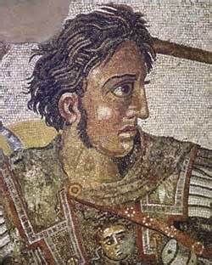
Alexander The Great

Slide 2
“There is nothing impossible to him who will try” – Alexander the Great
Greatest military leader in history – never lost a battle
The first person to receive the title of “The Great”

Slide 3
Son of King Philip II of Macedon and Princes Olympia
Philip II was a great military leader and organizer
Olympia was passionate and hot tempered
Alexander inherited the best qualities from both his parents

Slide 4
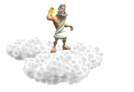

Alexander’s mother taught him that Achilles was his ancestor, and his father was descended from Hercules.
~Alexander was told by an oracle that his true father was Zeus and not Philip.

Slide 5

Illiad
Alexander learned by heart the Illiad, a story that tells about the deeds of Achilles, and carried a copy with him wherever he went.

Slide 6


At 13 years old, he became a pupil of Aristotle.
Aristotle inspired in Alexander the love for literature, sciences,philosophy and sports.

Slide 7
After his father’s death in 336 B.C., Alexander became king at the age of 20.
After Alexander became king, the surrounding territories revolted.
Alexander and his army stormed the city of Thebes and destroyed every building except the temples and the house of the poet Pindar.
30,000 inhabitants were sold into slavery.
Seeing this the rest of the territories surrendered, giving Alexander control of Greece.

Slide 8
Conquest
In 334 B.C., alexander’s Army marched across the Hellespont to invade the Persians under their King Darius III.
Alexander’s army consisted of 47,000 men where the Persian army numbered between 80,0000and 100,000 men.
Outmaneuvering his opponent Alexander crushed the Persian army again inflicting 10,000 to 20,000 casualties. He lost 450 men and 4,000 wounded.

Slide 9
He conquered the Persian Capital, Persepolis and from there the Persian empire fell before his feet.
The Persian king, Darius III fled like a coward, but ended up being assassinated by his own men.
Alexander hunted the assassins down and killed them for committing such a grave act.

Slide 10
In 331 while conquering Egypt Alexander established the famous city of Alexandria.
After conquering the territories of the Persian empire, Alexander turned his sights on India
He had heard about the vast riches found there and that beyond India was the end of the world.
It was here in the Indus Valley that Alexander and his army would face something they have never encountered before in battle, the Indian war elephant.

Slide 11
Alexander send 15,000 of his best men past the Indian cavalry and then marched back up to attack from behind. By wounding the elephants the animals became wild and turned on their own men causing chaos. Their King was taken captive and the battle was over.

Slide 12
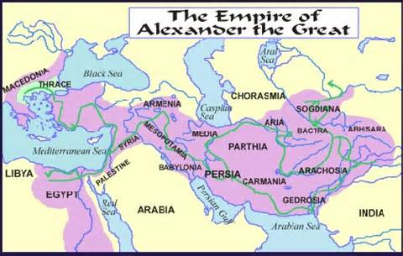

Slide 13
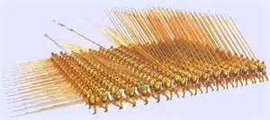
Alexander had a great military mind
Developed the Phalanx – a military box formation

Slide 14
Death of Alexander
Died at 33 years of age
It is still a Mystery to this day
Some believe it was a conspiracy involving People he was close to.
Some believed from Malaria
Some believed Poisoned wine

Slide 15
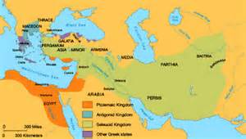
All of Alexander’s family were secretly killed
The empire was split into four section between Seleucus, Ptolemy, Cassander and Lysimachus.

